Slide 1
Event Handlers
IN721 2019
Design and Development for Mobile Devices
Session 2.1
Notes:
Most Android apps are interactive.
That is, you provide controls that the user can tap, slide, etc. and code is executed in response.
The Android classes have a very specific and idiosyncratic architecture and syntax for binding event handlers to control events, and that’s what we’ll be working on this week.
When you first see it, it may seem very odd, but once you learn the pattern, you just use it over and over again for all Android events, so development actually feels quite straightforward.
So if it’s puzzling at first, don’t worry, you just need a bit more practice.
We will be using two somewhat advanced (or esoteric) Java features, so we will start with a brief Java review...

Slide 2
Java Review
Essential Java concepts for Android event handling
Inner classes
Interfaces
Notes:
If you took Java with Dale, you will have already written event handlers, but in that class you used a simplified architecture, not the “correct” Android one
That approach was fine for very small apps, but it doesn’t scale.
That is, as soon as you want a more complex application, it become cumbersome.
This semester we will learn a better architecture.
It requires that you know these two Java concepts...

Slide 3
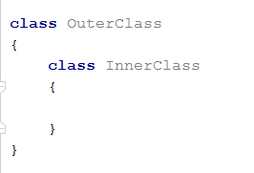
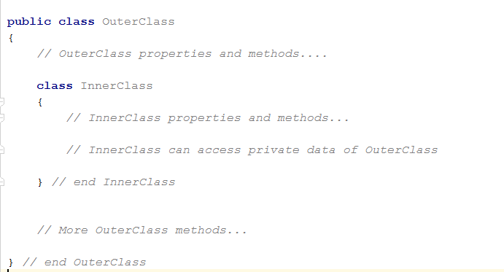
Java Inner Classes
Notes:
Java allows the declaration of inner classes – that is, classes whose declaration is contained within another class.
Schematically, as shown in the first image.
As shown in the second image, the outer class is just a normal class, which can have all the other methods and properties it needs.
The inner class effectively is part of, or belongs to, the outer class.
Therefore, the inner class can “see” all of the outer class’s data properties, even the private ones.
This makes it easier to write certain kinds of logic – you don’t have to keep passing data values in and out of an inner class instance, it can access those variables directly.
We said that the inner class belongs to the outer.
One implication of this is that an instance of InnerClass can exist only within an instance of OuterClass – you can’t make an instance of an inner class from some other place in the architecture.
Not all languages permit this. Think about the adv and disadv.
Adv: better encapsulation and decomposition. Especially nice for callbacks, as we will see.
Disadv: Coupling and loss of outer class privacy.
In Android, inner classes are used a lot, so get use to them.

Slide 4
Interface
A collection of logically related method declarations.
No data.
No code.
Not a class definition
Classes can “implement the interface”
They promise to provide code for every method included in the interface definition.
Notes:
As discussed at length in OOSD
A collection of logically related methods. No data. No code. Just a set of behaviours that generally go together.
(In languages that don’t support interfaces, this is equivalent to a pure abstract class.)
So an interface doesn’t say anything about how something is accomplished, it just says that here are some jobs that usually go together.
A class that implements that interface promises to provide methods to do all those jobs.

Slide 5
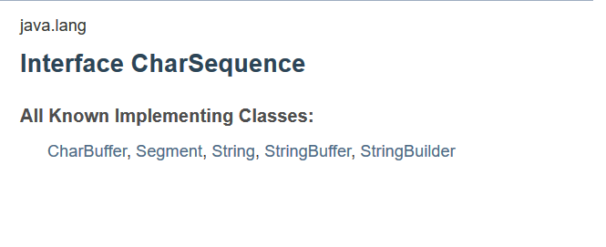
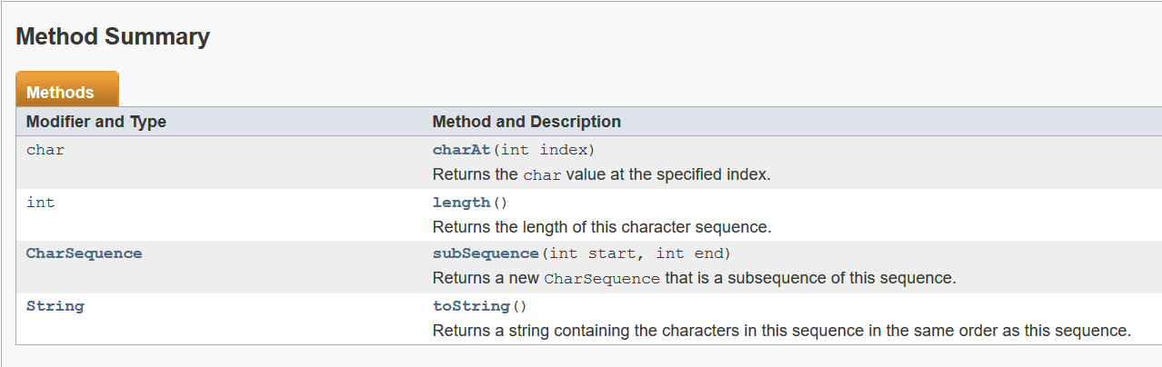
Interface
Notes:
Here is an example from the language.
Java defines the CharSequence interface
A set of related methods that involve dealing with different types of String-like objects
If a class chooses to implement the CharSequence interface, it must implement these four methods: ...
If the class doesn’t, the code won’t compile.
As it says in the docs (3rd image) this provides consistency and reliability on the way programmers access and operate on String-like things

Slide 6
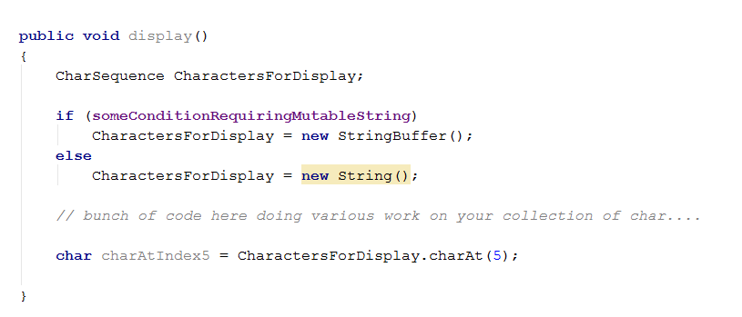
Interface as Type
An interface can be used syntactically like a type
Notes:
Interfaces are types.
That is, you can declare a variable whose “type” is an interface.
That variable can hold any object, of any class, which implements the interface.
As a (not very realistic) example, we can do the above:
CharactersForDisplay doesn’t have a specific class-type. It can be any object that implement the CharSequence interface
At runtime, we can decide what kind of concrete class object to give it.
Regardless of what we choose, we know that the object will support all the methods in CharSequence.
This would work exactly the same if we had a user defined type that implemented the CharSequence interface.

Slide 7
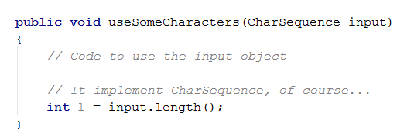

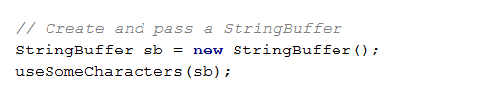

Interface as Parameter Type
Notes:
Similarly, we can define function arguments by an interface rather than a class type.
Continuing with charSequence...
Here is a method that will take an input of any class that implement the CharSequence interface
Elsewhere in the program, we can call this method and pass it any appropriate class.
These all work because Strings and StringBuffers implement CharSequence
It would work exactly the same with a user-defined type that implements CharSequence

Slide 8
Handling Events in Android
Widgets/controls support events
Android contains interfaces which define event handler methods.
In the Activity which manages the widget, we declare an inner class which implements an appropriate interface.
We write the interface methods.
We bind an instance of the inner class to the control.
Notes:
So, why do we care about inner classes and interfaces...
...
Note that there are alternative syntactic approaches to this which produce shorter, more compact code, and you will see them in the wild.
Later in the semester, you may even use them yourself.
But for now, we will do it this way, because it is much easier to see what is going on.

Slide 9
Binding Event Handlers
widget.eventSetter(objectThatImplementsInterface)
Notes:
Here, schematically, is the eventual goal.
We have a reference to the Widget (how did we get it? → findViewByIf(R.id.widgetName)
It exposes a set method for each event if can respond to.
We create an inner class that implements the interface we need (examples in a moment)
In the onCreate create an instance of that class
We pass that instance to the set method.
Let’s look at an example.

Slide 10
Example
Buttons support the onClick event
Bind with setOnClickListener
Requires an object that implements the OnClickListener interface.
The handler method is onClick(View v)
Notes:
So if you look at the definition of the OnClickListener interface, you will see that one of the methods it contains is onClick
Actually, this is the only method it contains.
So assume we have an Activity with a button. How do we attach some code to the button click?
We have some choices....

Slide 11
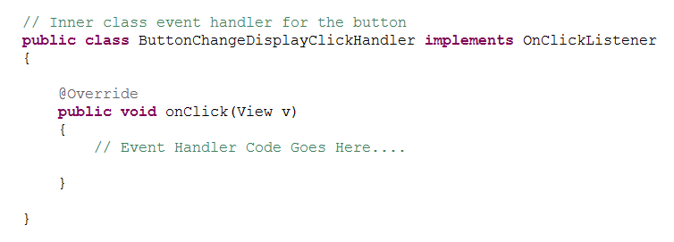
Architecture
Define the handler as a separate inner class in the Activity
Notes:
We create a class that implements OnClickListener and, therefore, provides code for onClick(View v)
Like this...
What is the advantage of defining as an inner class? => access to consumer's fields and methods
Here’s some code we might put into the onClick method...

Slide 12
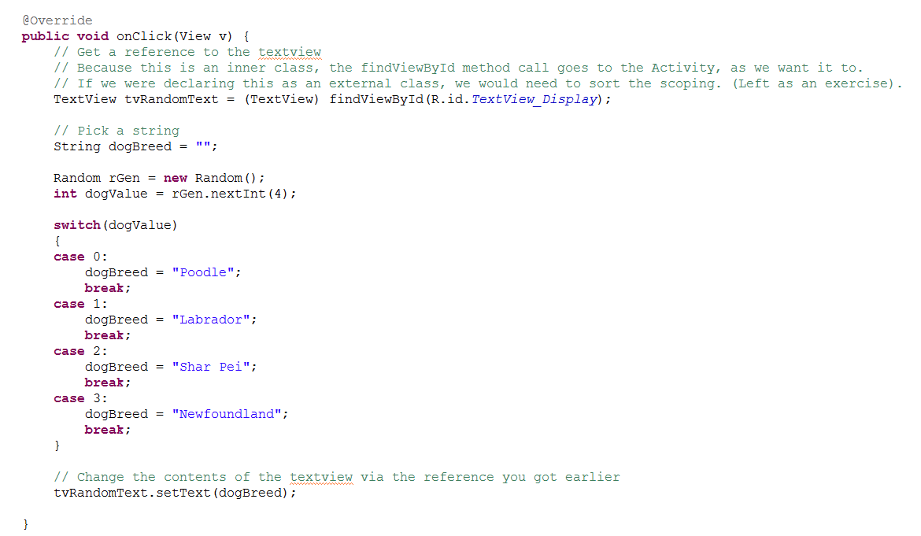
Example
Notes:
Here is some code we might put in that onClick method from the previous slide...

Slide 13
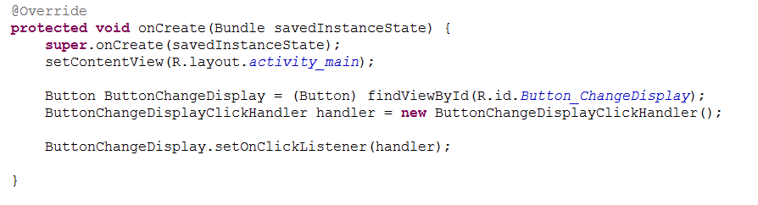
Example
In the onCreate, create an instance of the inner class, and bind it to the button.
Notes:
In the onCreate OR WHEREVER YOU WANT TO BIND THE CLICK EVENT
Looks like this...
See the steps.
Get a reference to the button
Make an instance of the class
Call setOnClickListener passing in the instance.
Now, if someone clicks on the button, the onClick code of the passed instance is executed.

Slide 14
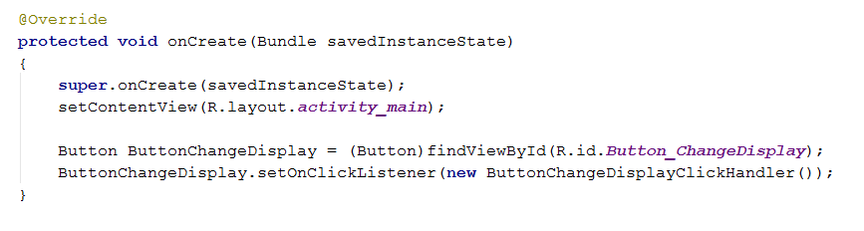
Syntactic Alternative
Omit the assignment of the instance to a variable.
Notes:
Inner class ButtonChangeDisplayClickHandler implements OnClickListener is as before.
Here, we omit the step of creating the instance and putting it into a variable, which we then pass to the set method.
Instead, we call the constructor in the set method itself.
This creates the instance and passes it to the method.
This is legal Java, and as far as setOnClickListener is concerned, there is absolutely no difference between these two.
(Here’s the previous approach for comparison)
What’s the difference from a pragmatic perspective? -> In the second approach, we have the instance saved in a variable in case we want to use it again. For example, we might want to bind it to some other control. In the first approach, we can never refer to it, because we didn’t store a reference to it.

Slide 15
Thinking about language design....
Notes:
We have just looked at two syntactic options.
Now let’s look at a different architectural option.
There is overlap between these two notions (syntax and architecture), but generally, we use architecture to refer to the arrangement of classes in our code.
In this next technique, we don’t make the inner class....

Slide 16
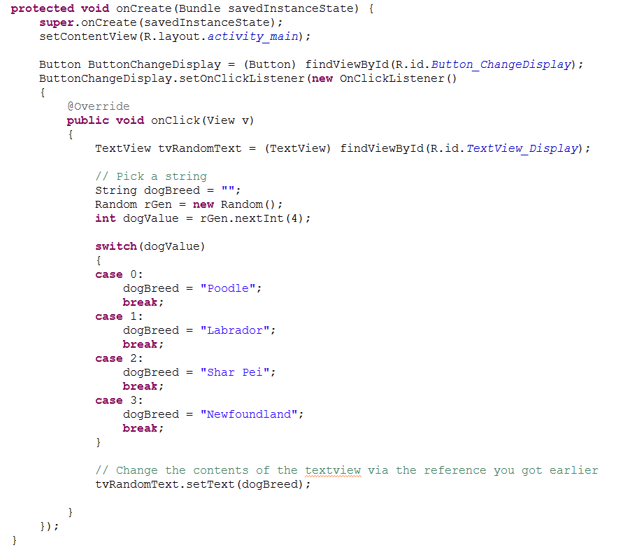
Architectural Alternative – Anonymous Class
Notes:
Instead of declaring a class, then making an instance then binding it, you do the whole thing in one statement in the onCreate.
There is no inner class.
Call setOnClickListener, and where you need to pass in that interface implementer, just declare a new implementer and provide its code.
This is “anonymous” because you never name a class or an instance.
It looks like this.
See that “new OnClickListener()”? That means “Get ready, because I am now going to create an object that implements the interface OnClickListener”.
This is legal Java
Note that the code of the onClick method is identical, and the behaviour of the button is identical.
Remember always that the syntax and semantics of a programming language are not a law of physics or a biological characteristic. Every language feature is a decision made by the language’s author.
Getting these right (or not) determines the power and usability of a programming language.
If you plan to write the next big language (like the person who came up with php, or with node.js), you will have to make all these decisions.

Slide 17
Which Architecture to Choose?
Inner class vs. Anonymous Class
Which of these do we find more readable?
Which will you find more readable when there are lots of controls and lots of events?
Will you see the other one anyway in the wild?
Why?
Notes:
As a programmer, you have to look at what you can do with a language and decide what is best in each context.
Let’s compare these two architectures – explicit and anonymous inner class.
Which of these do we find more readable? => Class.
Which will you find more readable when there are lots of controls and lots of events? => Class.
Will you see the other one anyway in the wild? +> Yes.
Why? => Programmers are lazy?
There is really no agreed "best practice“ in Android yet. Worth doing some reading to see different stated pros and cons.

Slide 18
Other Syntactic Options
http://androidcookbook.com/Recipe.seam?recipeId=2359
Notes:
E.g. You can define the method right in the Activity class and add the implements interface modifier to it.
Etc. etc.
Keeping in mind what you really have to accomplish here – pass in an object to setOnClickListener which defines an onClick event – can you think of any other syntactic approaches?
The goal IS NOT TO PRODUCE SHORT CODE.

Slide 19
Toast
Toast (android.widget.Toast) exposes two important methods:
the static method makeText
the instance method show.
Notes:
We are going to do a practical now, but first we want to meet a useful little Android class - Toast
Toast is a useful class for displaying small bits of text on the app screen at runtime (like MessageBox().Show() in .NET or alert() in JavaScript),

Slide 20
Toast
makeText is (like) a constructor
Context context | The current activity
CharSequence text | The literal string you wish to display
int duration | The amount of time you wish to show the Toast text for. Although this variable is of type int, you can’t just pass in any value you want. You have to use one of the Toast class constants (static ints) LENGTH_LONG or LENGTH_SHORT.
Notes:
That is, it returns a Toast object
Note that it is static. This means that you don’t need a Toast instance to call this method on, you can call it directly on the class name.
This is important because, this is the method we use to create an instance, so if we needed an instance to call it, we’d be stuck.
Is this a violation of the normal OO pattern? Yes. Can you cope? Yes. Because you understand about static methods and how they work. Why did they do it this way? No idea, frankly. Someone should look that up.
The argument are…
Where did I find this out? → The Android documentation.

Slide 21

Toast
Notes:
If, for example, we wanted to raise a little message from inside our Activities onCreate method, we could create an appropriate Toast instance like this:
After the Toast is created, you display it to the screen with the show() command.
Show() is an instance method. You call it on an instance.
For example, if we have created Toast statusToast above, we could raise it with:

Slide 22
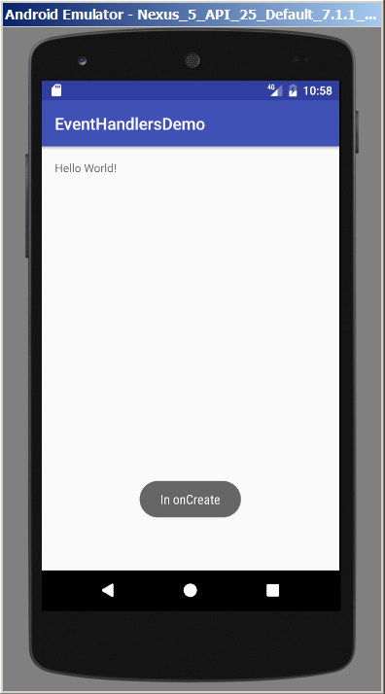
Toast
Notes:
Because this code is contained in the onCreate method, it is executed when the application starts, and it looks like this:
The Toast message pops up for a few seconds, and then fades away.

Slide 23
Toast
Notes:
Note that you will often see these two lines of code compressed into one, as follows:
Since you are chaining the call to show onto the call to makeText, you don’t need to store the Toast as an instance.

Slide 24
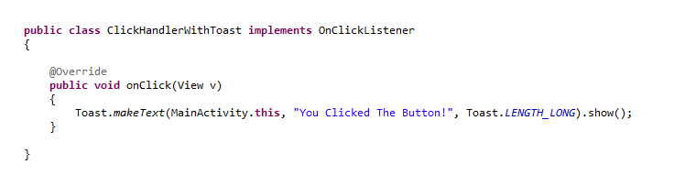
Using Toast in Event Handler Classes
You can’t access the Activity with “this” from inside an inner class.
Use ActivityClassName.this
Notes:
As stated above, to bind code to events, we create inner classes and object instances that support the relevant interfaces.
When we do this, the handler code method (for example, the code in onClick(View v) when working with button click events) belongs to the handler object instance (an instance of the inner class) not to the Activity.
This changes the way we must call Toast.makeText. Specifically, we can no longer pass “this” in as a reference to our activity. If we use “this” inside the inner class, it refers to that inner class, not to the containing Activity class. To correctly refer to the containing activity, you must say…
For example, assume that we have an Activity class called MainActivity. We wish to wire up a button click handler, so we want to declare an inner class that implements OnClickListener. To use Toast in that handler we can say:

